Slide 1
Co-beneficial Air Quality and Climate Mitigation
Hans- Christen Hansson
Stockholm University
Sweden

Slide 2
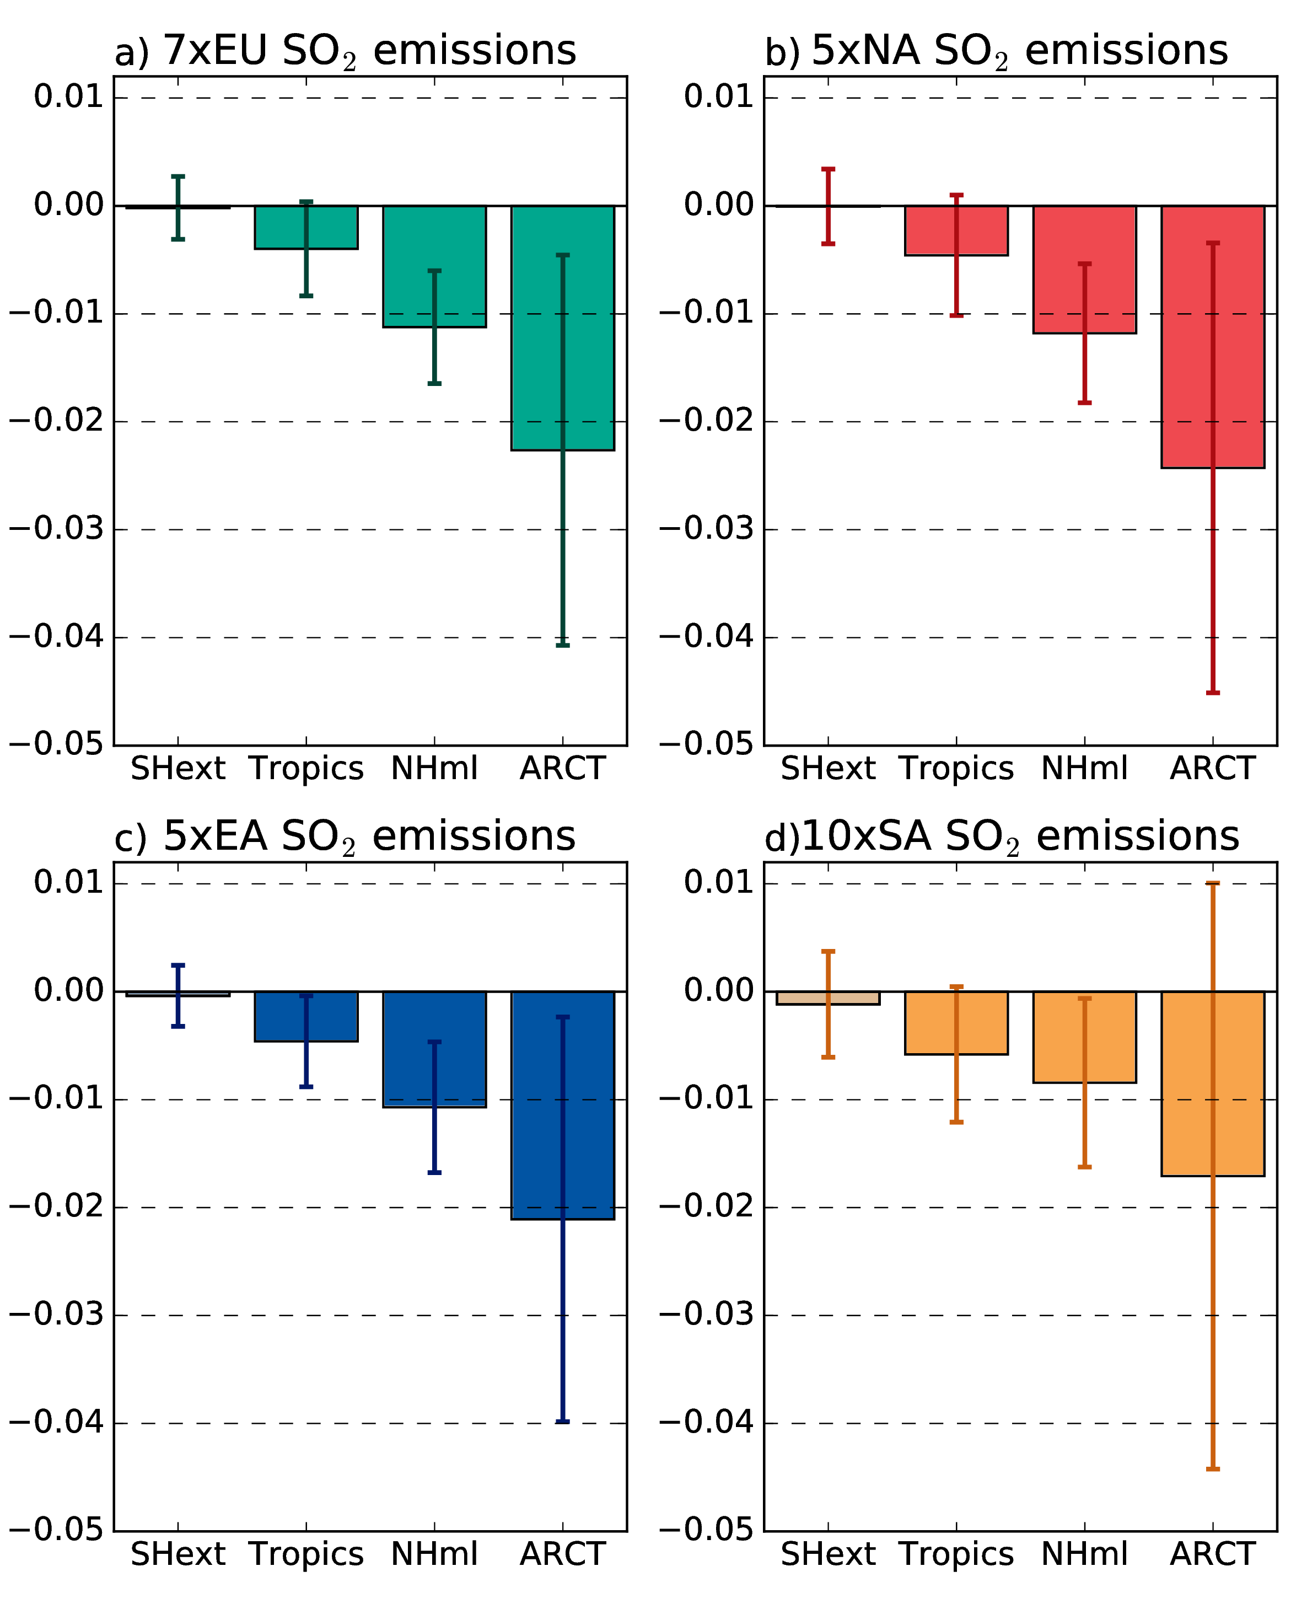
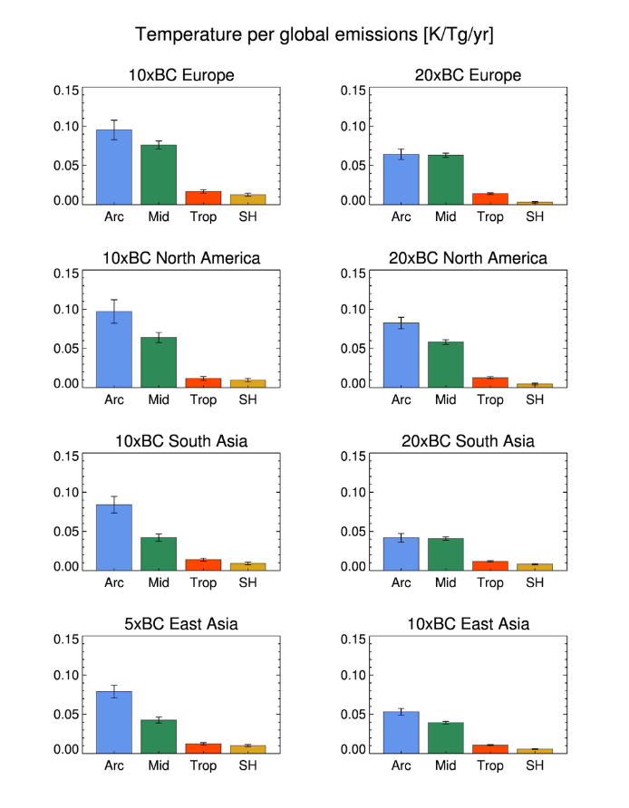
Temperature change per unit emission
(simulations using NorESM)
Effect of SO₂
Effect of BC
Climate neutral emission mix is possible!!
1 ton reduction of sulfur can be climate compensated by a 250 kg BC reduction.
[ºC / TgS year⁻¹]
[ºC / TgBC year⁻¹]
Lewinschal et al. (2019)
Sand et al. (2020)
Notes:
Reference year is 2000
Simulations are equilibrium simulations for 160-200 years.
Each subplot is for a certain emission region (i.e. top left is when changes are done within the European domain)
Y-axis shows temperature response
X-axis shows response region (Arctic, Mid-latitudes, tropics, southern hemisphere)
The temperature response is always the largest in the Arctic
It doesn’t matter where the emission changes are done. Slightly weaker response for South Asian emissions
Temperature response for BC is ~5 times temperature response for SO2.

Slide 3
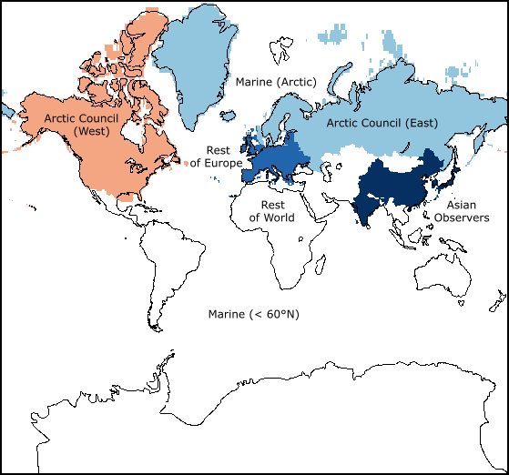
AMAP report focus on AC and AC observers

Slide 4
Analysis of SLCF’s influence on the Arctic climate
Five fully-coupled Earth system models used NorESM-happi (3 ensemble members), CESM2 (4 ensemble members), MRI-ESM2 (5 ensemble members), GISS-E2.1 (3 ensemble members), and UKESM1 (3 ensemble members)
CTMs; EMEP-MSCW, CAN-MPI and emulators, e.g. TM5-FASST
SLCF’s: S, BC, OC, CH₄ and O₃ with precursors

Slide 5
Emissions BC, SO₂ and CH₄
MFR assumes another 70% decrease for BC, 50% for SO₂ and CH₄ for both Arctic council and observer countries.
Source; IIASA

Slide 6
Earlier results corroborated!
Past climate changes in the Arctic, 1990-2015, due to increasing CO₂ and decreasing SO₂ emissions. Half of the temperature increase of about 2-2.5 degrees C can be due to the SO₂ emission decrease! As the emission changes of other SLCF’s were relatively quite small.
Two scenarios CLE and MFR, 2015 – 2050, using SSP2-4.5 CO₂ scenario as base show a further strong influence of SLCF’s on Arctic temperatures:
  CLE at 2050: CO₂ +1.2℃ , SO₄ +0.4℃, BC -0.15℃ and CH₄ +0,15℃. Total: +1.6℃
  MFR assumes a further 70% decrease for BC, 50% for SO₂ and CH₄ for both Arctic council and observer countries.
  MFR-CLE at 2050: SO₄ +0.12℃, BC -0.11℃ and CH₄ -0.16℃.
  Total: -0.13℃

Slide 7
Warming Arctic
Regional
proceses
amplify
warming

Slide 8
Impact on PM2.5 concentrations and health compared to 2015
Region | CLE at 2050 | MFR at 2050
Arctic | -15% | -40%
AC east | -20% | -45%
AC west | -30 | -40%
AC observers | -30 | -75%
Health impact, premature death | CLE at 2030 | MFR at 2030
AC | 66 000 | 97 000
AC observers | 540 000 | 880 000

Slide 9
Conclusions:
Present air quality improvement mainly due to SO₂ emission decrease. Large climate penalty with a double temperature increase.
Huge gain in air quality with CLE scenario especially in Asia (about 0.5 million premature deaths). Another 0.5 million more with MFR.
About same climate penalty with CLE and MFR, 33 and 23% higher temperature increase compared with CO₂.
Climate mitigation calls for focus on reduction of BC and CH₄ emissions. While air quality mitigation calls for reduction of PM2.5 concentration.
Asian emissions dominate climate impact, while regional emissions affects the regional health impact.
Moral: Air quality and climate mitigation have to be coordinated!

Slide 11
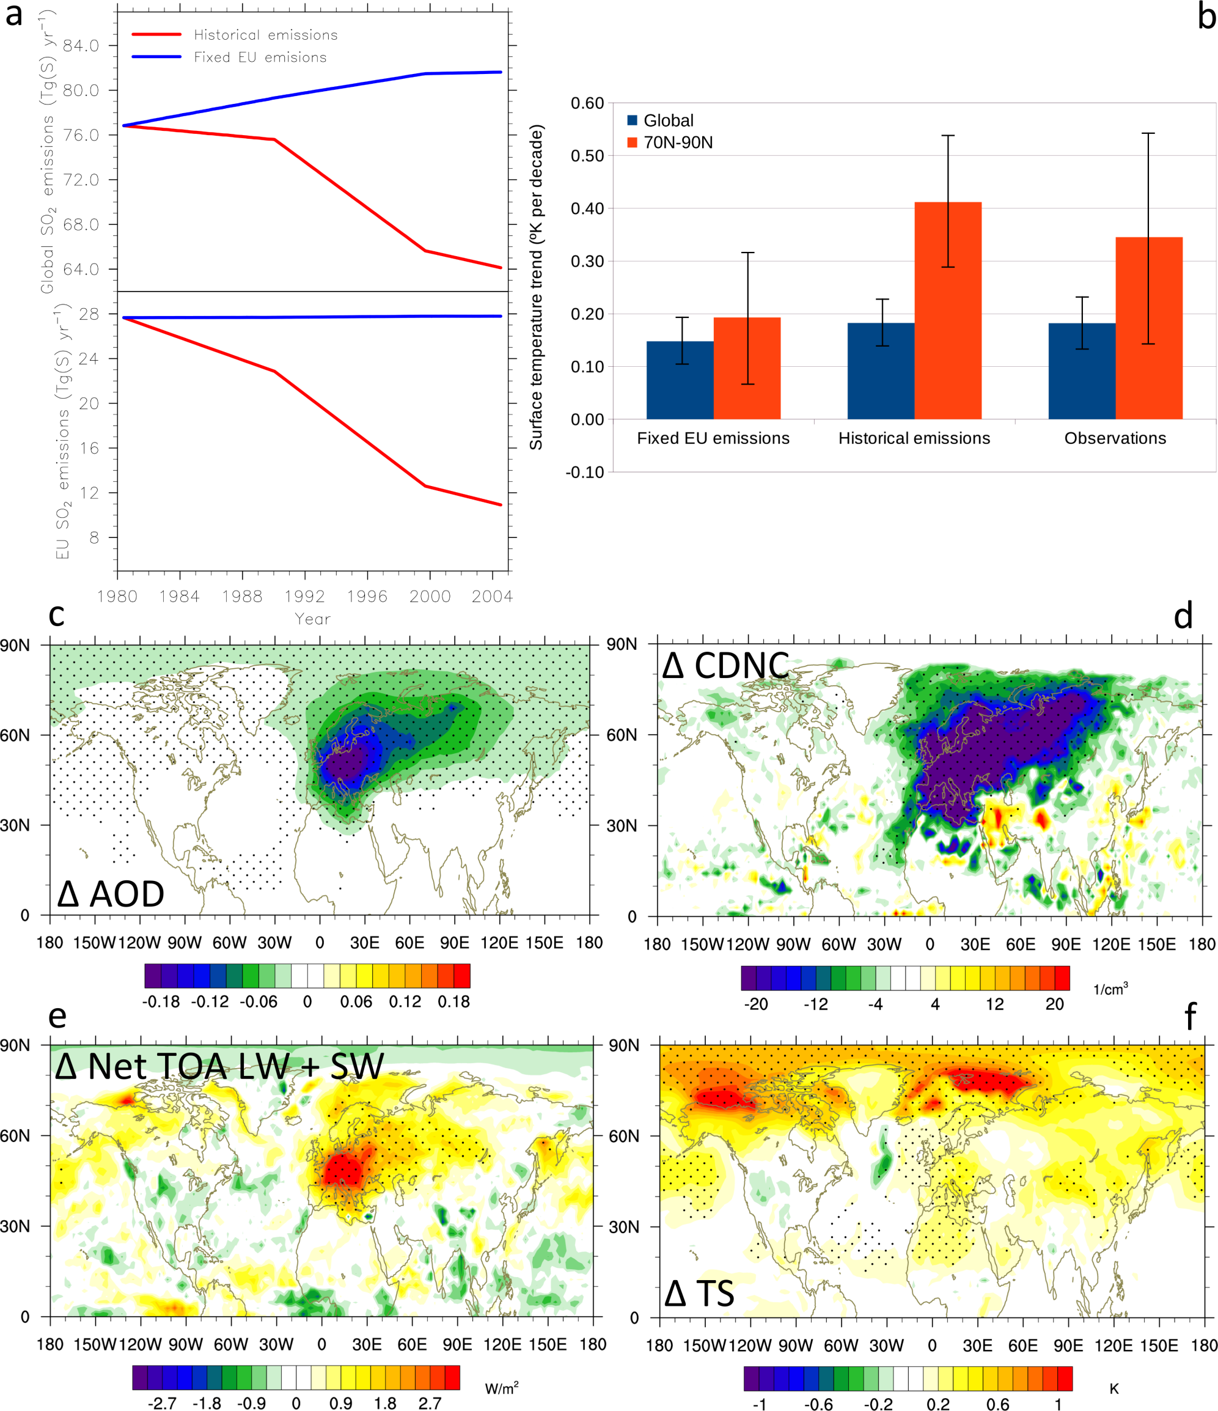
Effect of reduced European SO₂ emissions 1980-2005
Top of the atmosphere
net radiation change
Surface temperature change
[Wm⁻²]
[K]
Dotted areas indicate significance at 95% level (student’s t-test)
Acosta Navarro et al. (2016). See also Shindell and Faluvegi (2009); Yang et al. (2014); Westervelt et al. (2015); Gagné et al. (2015)
Notes:
Note that the temperature response is only due to the changes in SO2 emissions – it’s not the actual simulated temperature change in the Arctic.
The temperature response does not follow the radiation change.
If we look at it in numbers it is quite clear. The main reason is not transport of aerosols and a local radiative effect.
The main reason is that the extra input of energy over Europe, the extra heat, is transported from the region towards the Arctic.
Once in the Arctic, the signal gets amplified just as it is for GHG forcing.
The effective radiative forcing is .24 - 0.54 = +0.70 W/m2 for the Arctic and 1.92 - 0.22 = +1.7 W/m2 for Europe.
For fixed SSTs, the TOA net radiation is slightly positive in the Arctic.

